Slide 1

MEDICAL CENTER OF EXCELLENCE
TO CONSERVE FIGHTING STRENGTH
DEVELOP LEADERS ● DRIVE CHANGE ● INFORM
Expert Field Medical Badge (EFMB)
Blackboard Guide
EFMB Test Control Office (TCO)
U.S. Army Medical Center of Excellence

Slide 2
Agenda
Host Unit Responsibilities
Proctor Requirements
Proctor Responsibilities
Candidate Enrollment
Welcome Page
References & Resources
Survey
Written Test
Written Retest
Grades

Slide 3
Host Unit Responsibilities
Notify TCO desired test availability timeframe
Submit all test board members EFMB orders to TCO
Receive, process, secure, and safeguard EFMB digital written test site, along with written test and retest passwords
Distribute “EFMB Student Self-Enrollment Procedures” and “EFMB Blackboard Guide” to all prospective candidates and/or their leadership
Receive written test and re-test passwords from EFMB TCO
Ensure all assigned proctors are EFMB awardees in the rank of E-5 or above
Brief proctors on their responsibilities and provide “EFMB Blackboard Guide”
Provide written test and re-test passwords to proctors or their unit Commanders

Slide 4
Proctor Requirements
EFMB Awardee
E-5 or above
Assigned by Unit Commander

Slide 5
Proctor Responsibilities
Provide orders to requesting Unit Commander
Coordinate date/time for testing with Unit Commander and candidate
Coordinate quiet testing location equipped with computer and reliable internet connectivity
Secure written test password from Unit Commander (Different from Blackboard site access code)
Ensure only candidates log into the EFMB Blackboard site. At no time will the proctor enroll in the site.
Provide candidate with blank sheet of paper and a writing utensil
Type password into password field (Do not give password to candidate)

Slide 6
Proctor Responsibilities
Remain in testing location at all times while candidate is executing exam
Ensure candidate takes test unassisted (no notes/references, no additional open internet browsers, no phones, no discussing questions with other candidates, etc.)
Ensure candidate does not copy any questions from the exam into any other platform
Ensure candidate logs completely off of Blackboard upon completion
Secure scratch paper from candidate and shred immediately
Contact EFMB Test Control Office with questions or concerns at usarmy.jbsa.medical-coe.mbx.efmb-test-control-office@mail.mil, 210-529-4338, or 210-896-1590

Slide 7
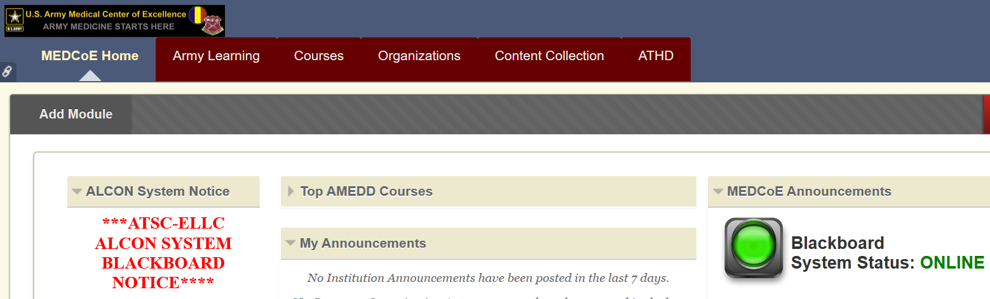
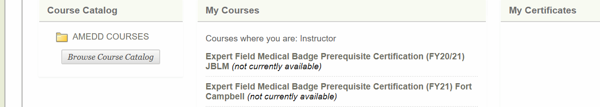
Candidate Enrollment
1) Log into Blackboard at the URL below using CAC and PIN or AKO username and password: MEDCoE’s BB URL: https://medcoe.llc.army.mil
2) Click on the “Courses” link at the top of the page.
3) Click on the “Browse Course Catalog” button.

Slide 8
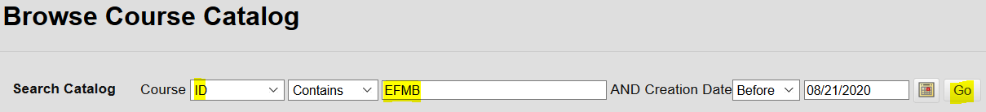
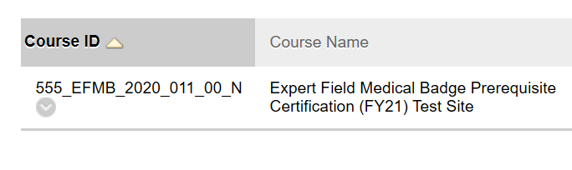
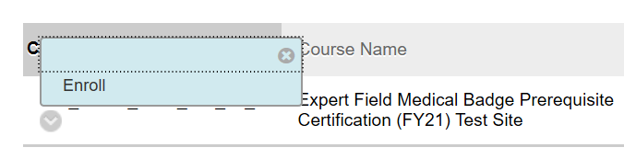
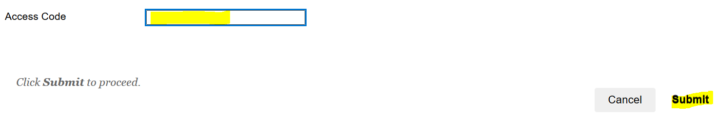
Candidate Enrollment
4) Select “ID” next to Course and type “EFMB” into the cell and push “Go”. The EFMB courses will appear at the bottom of the page. Select the course name corresponding to the EFMB site you will attend.
5) Click the drop down chevron next to the Course ID and select “Enroll”.
b.
a.
6) Type site specific access code (from EFMB Student Self-Enrollment Procedures document) in the “Access Code” cell and push “Submit”. Access code is different from written test passwords.

Slide 9
Candidate Enrollment
7) Candidate can now access the EFMB written test course by clicking the “Courses” link at the top of the page.

Slide 10
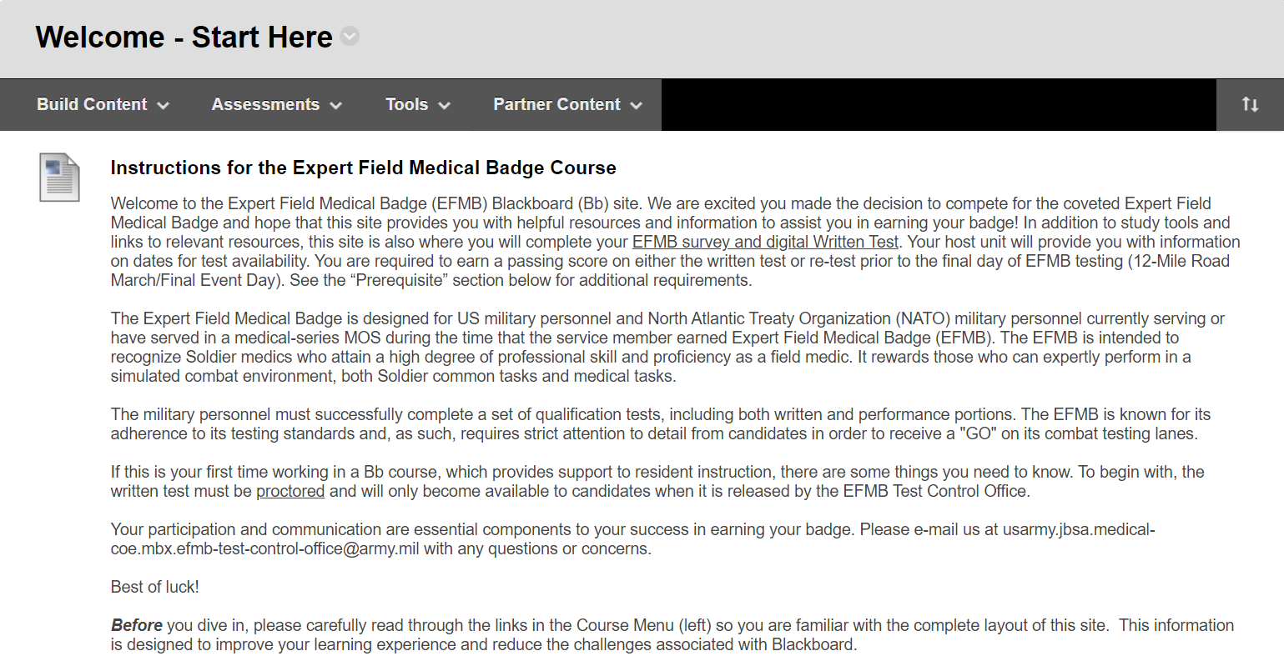
Welcome Page

Slide 11
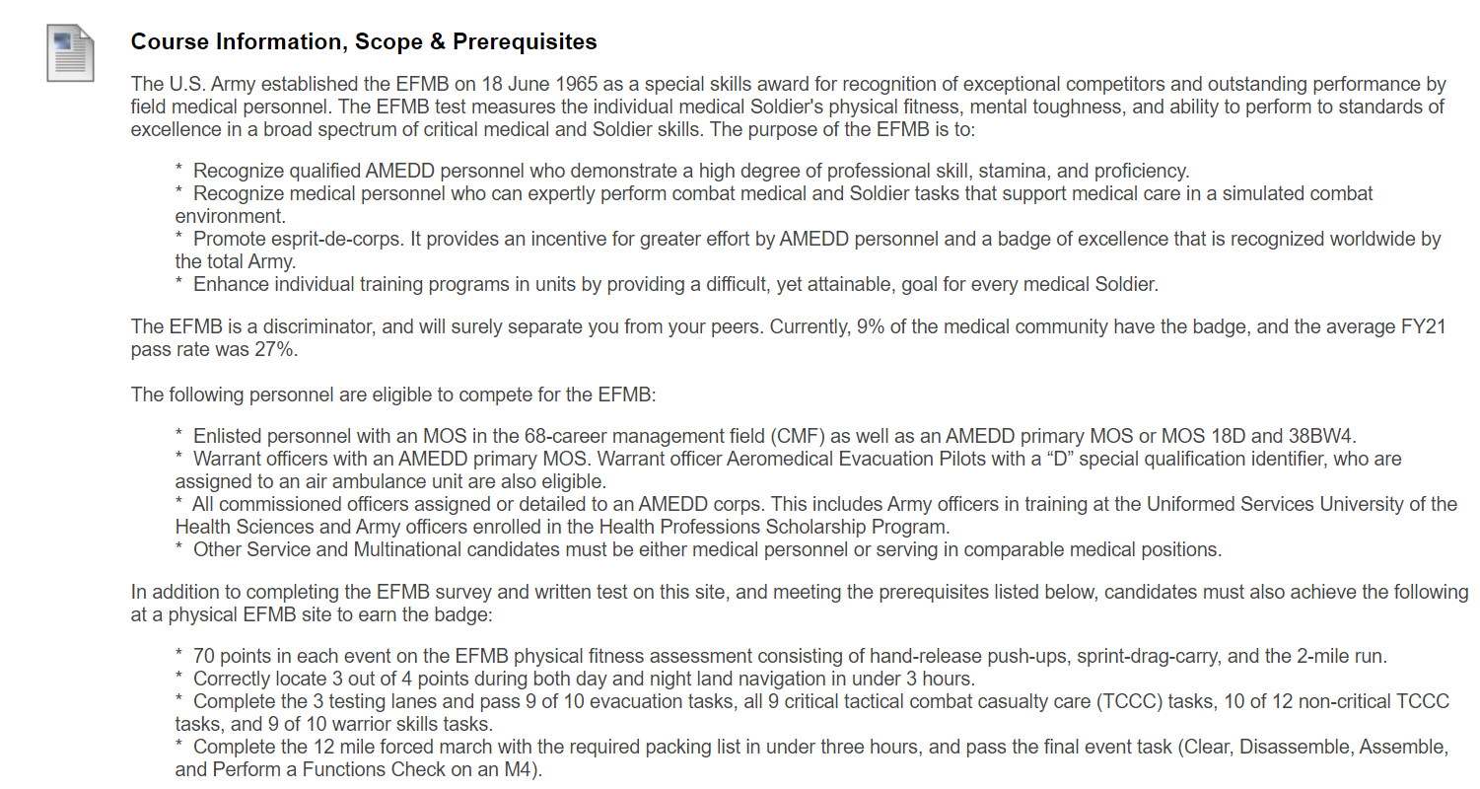
Welcome Page

Slide 12
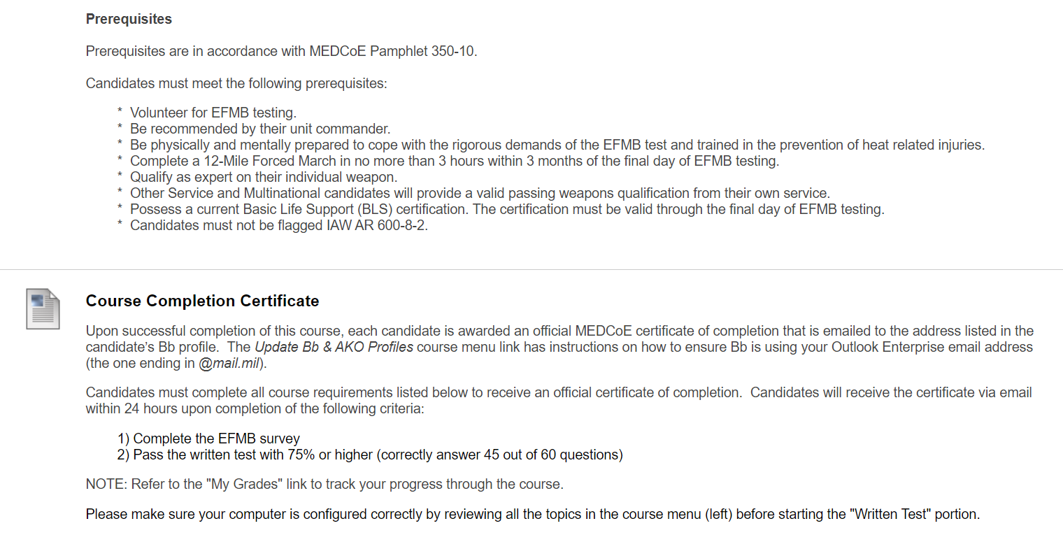
Welcome Page

Slide 13
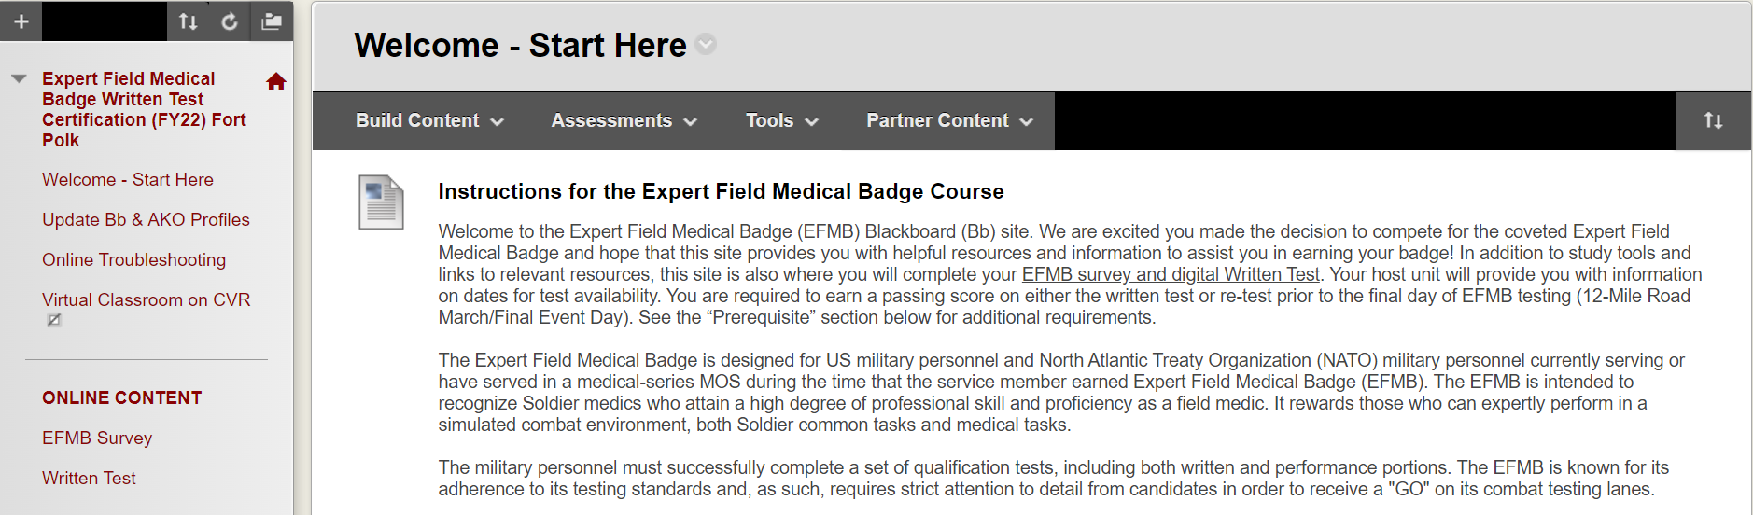
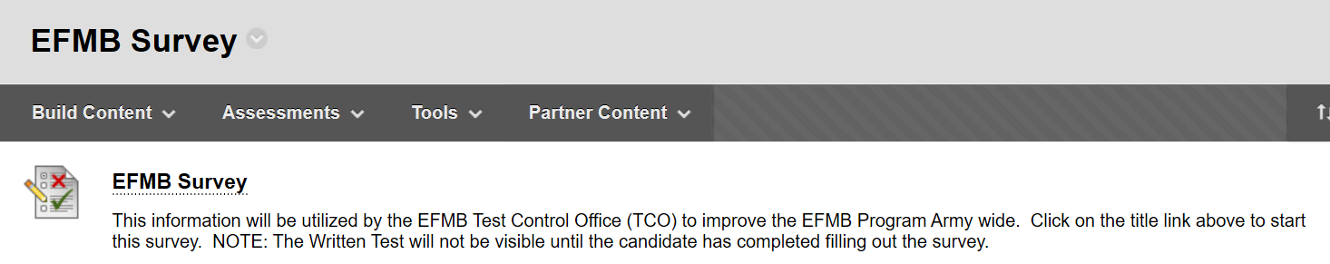
Survey
1) To access the survey, click the “EFMB Survey” link located under “ONLINE CONTENT” on the Course Menu.
2) Click “EFMB Survey” link.

Slide 14
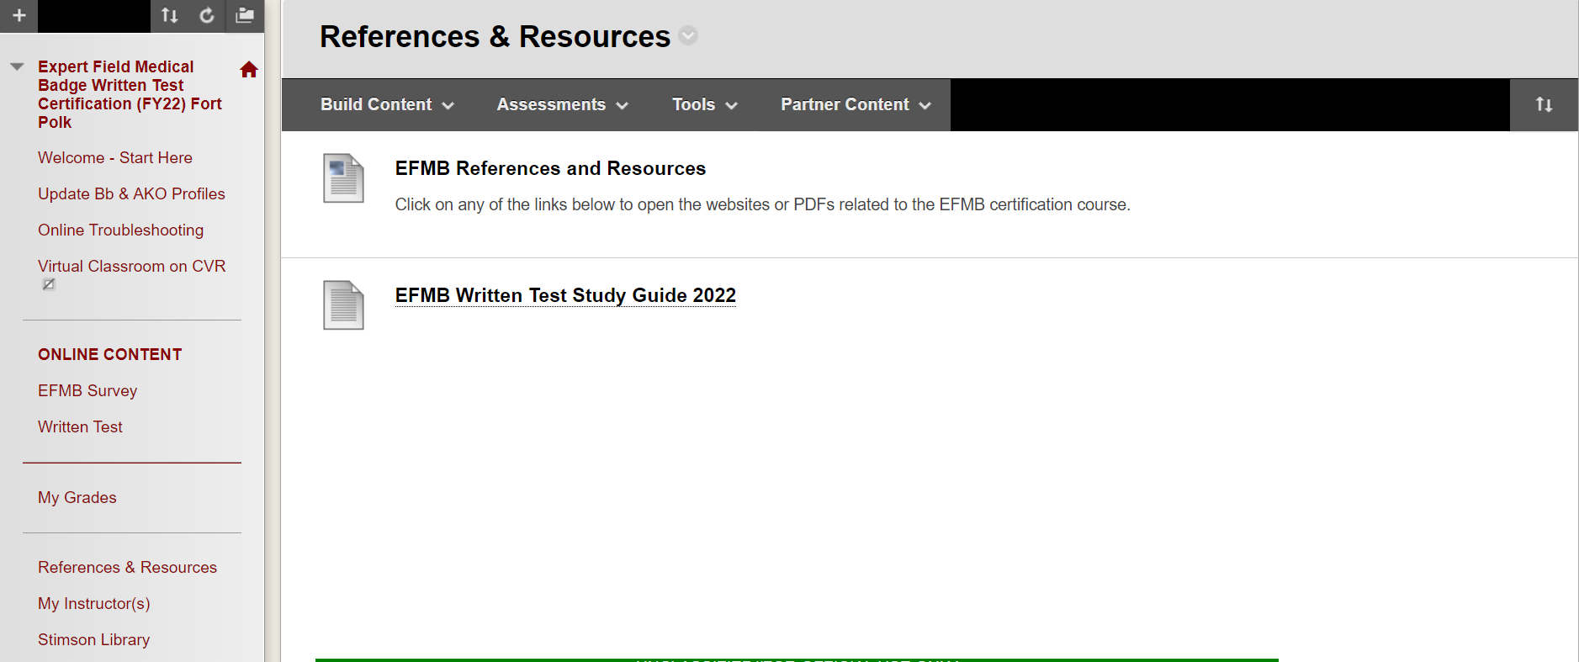
References & Resources
Candidates can access all EFMB study materials by clicking the “References & Resources” link.

Slide 15
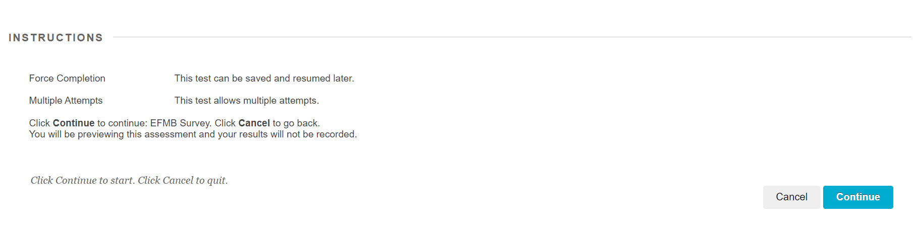
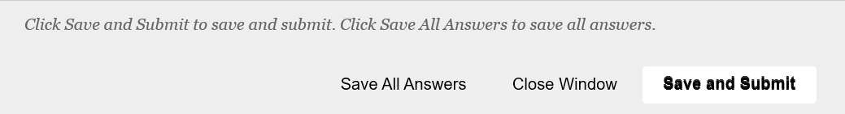
Survey
3) Click “Continue” and fill out survey.
4) After answering all questions, click “Save and Submit” to complete survey.
Candidates can complete the EFMB survey without a proctor present.

Slide 16
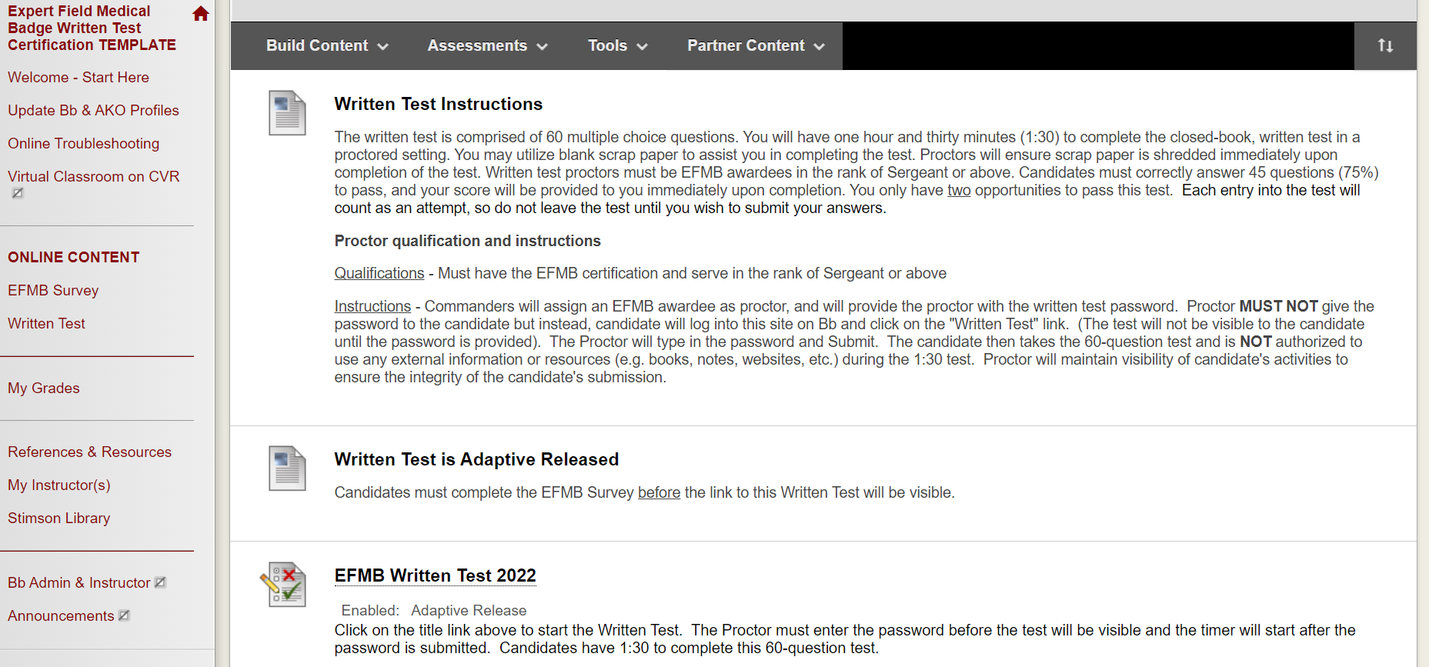
Written Test
To access the written test, click the “Written Test” link located under “ONLINE CONTENT” on the Course Menu.
Click “EFMB Written Test 2022” link to access written test. Link will not be available until survey is complete.
a.
a.
b.

Slide 17
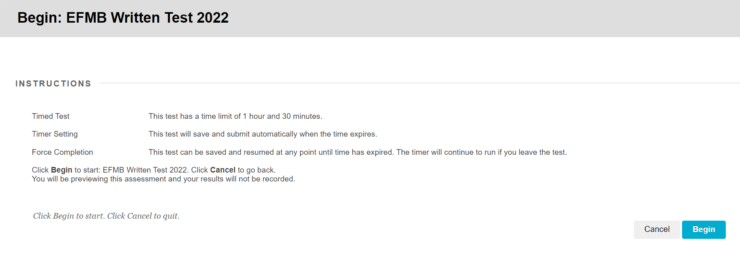
Written Test
3) Review instructions and click “Begin”. 90 minutes begins as soon as candidate presses “Begin” button. Timer will continue running without interruption, even if candidate steps away from test or logs out of test for any reason (i.e. bathroom break).

Slide 18
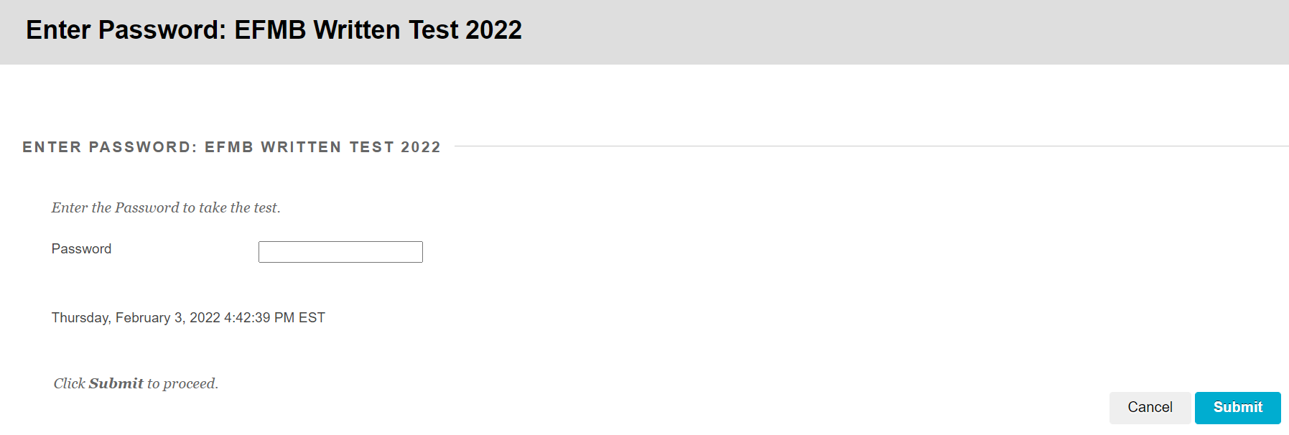
Written Test
4) Proctor will enter written test password and click “Submit”. (Written test password is different from course access code.)
a.
b.
5) After answering all questions, click “Save and Submit” to complete written test.

Slide 19
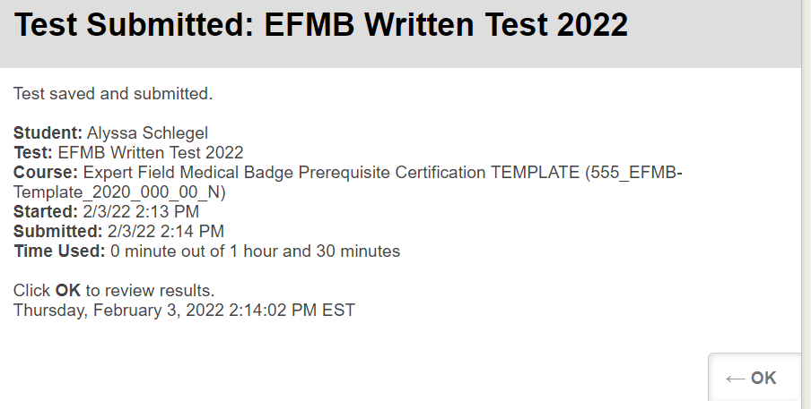
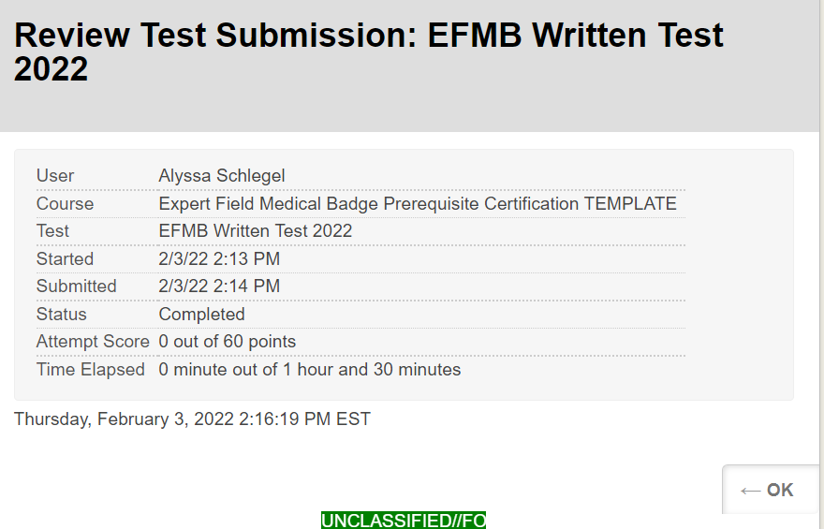
Written Test
6) Click “OK”.
7) Review score and click “OK”.

Slide 20
Written Test
8) Post Test:
If candidate received a passing score (at least 45/60 or 75%), Blackboard will e-mail a certificate to the e-mail associated with the Blackboard account. Candidate will include the certificate in candidate packet.
If candidate did not receive a passing score, then he/she should take at least a week for additional studying, and then proceed to the Written Retest.

Slide 21
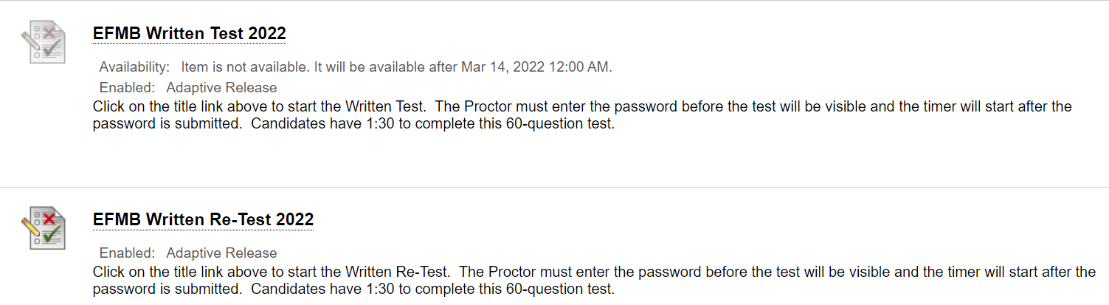
Written Re-test
1) Click “EFMB Written Re-Test 2022”. (Link will only become available after receiving a score of 44 or lower on the first written test.)
2) Review instructions and click “Begin”.
3) Proctor will enter written retest password and click “Submit”.
(Written retest password is different from course access code and written test password.)
4) After answering all questions, click “Save and Submit” to complete survey.
5) Click “OK”.
6) Review score and click “OK”.
Reference slides 16-18 for images.

Slide 22
Written Re-test
7) Post Test:
If candidate received a passing score (at least 45/60 or 75%), Blackboard will e-mail a certificate to the e-mail associated with the Blackboard account. Candidate will include the certificate in candidate packet.
If candidate did not receive a passing score, then he/she is ineligible to in-process the EFMB site associated with that Blackboard site. The candidate can attempt to participate in another site’s EFMB event.

Slide 23
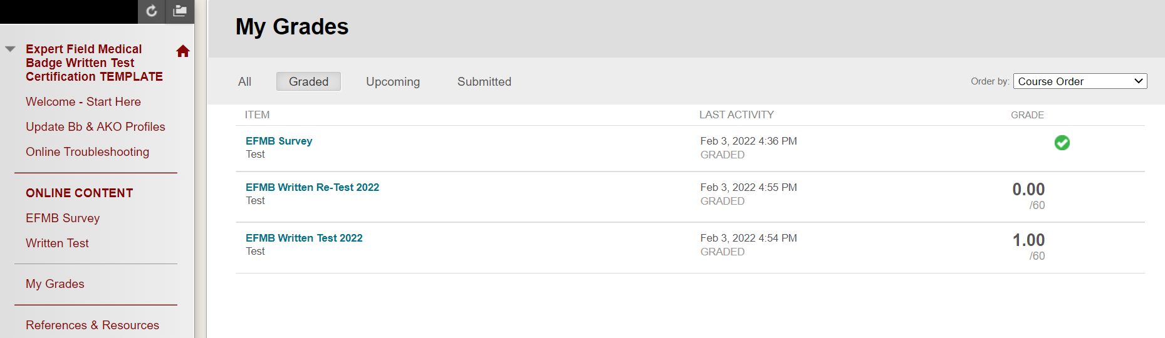
Grades
Candidates can access grades by clicking the “My Grades” link on the Course Menu.
A passing score is 45/60 correctly answered questions or a grade of 75% or greater.

